Slide 1
Results for lPFC

Slide 2
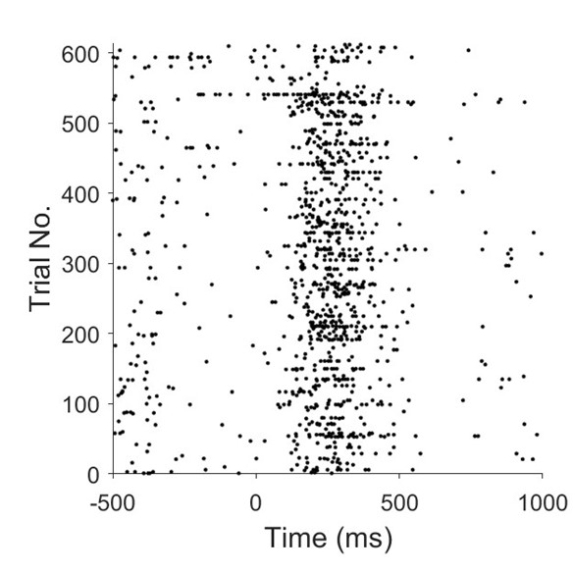
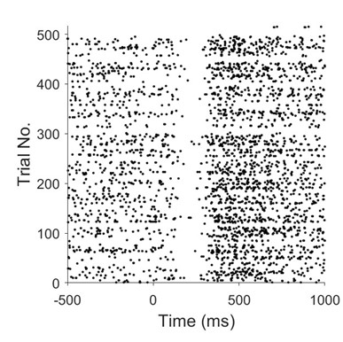
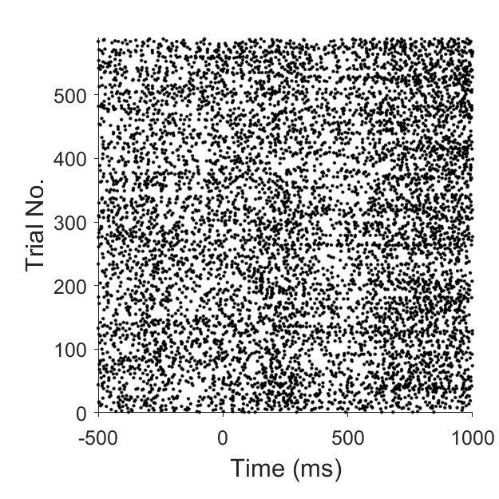
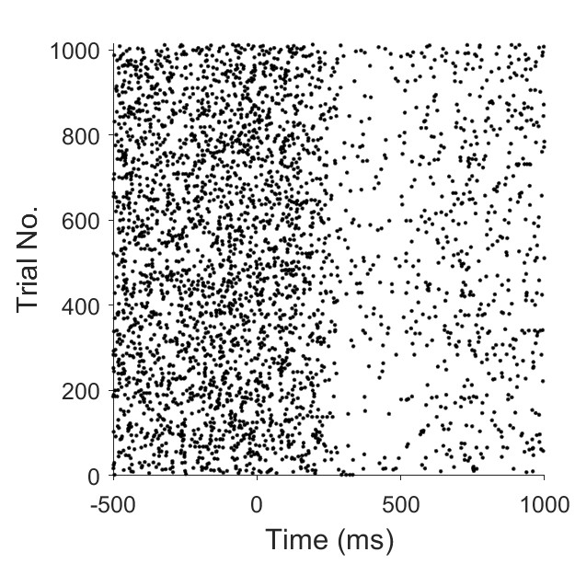
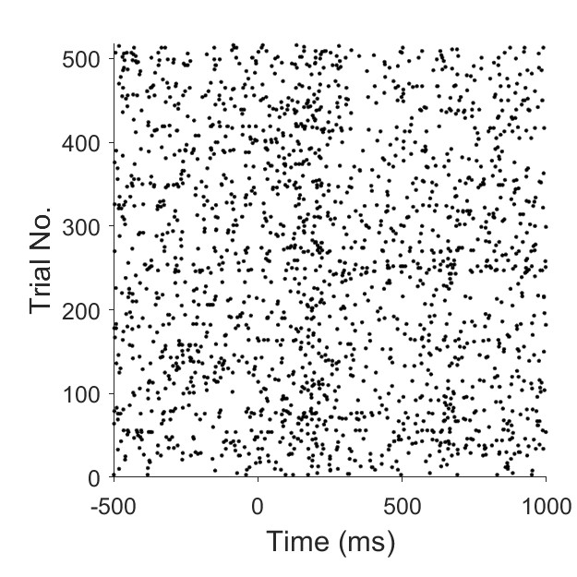
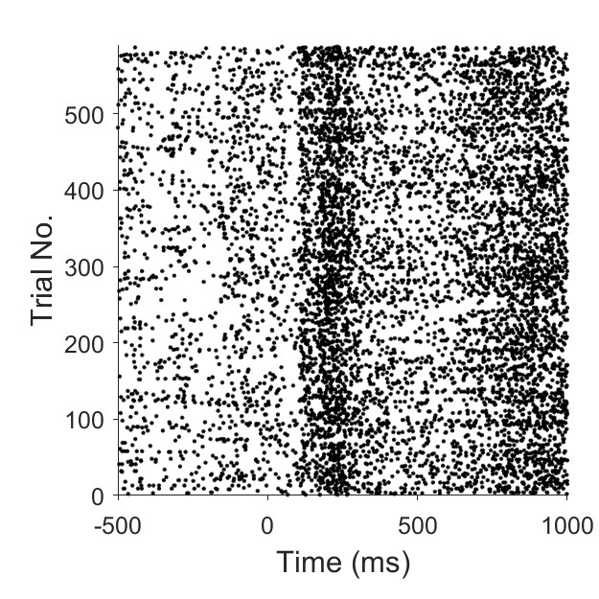
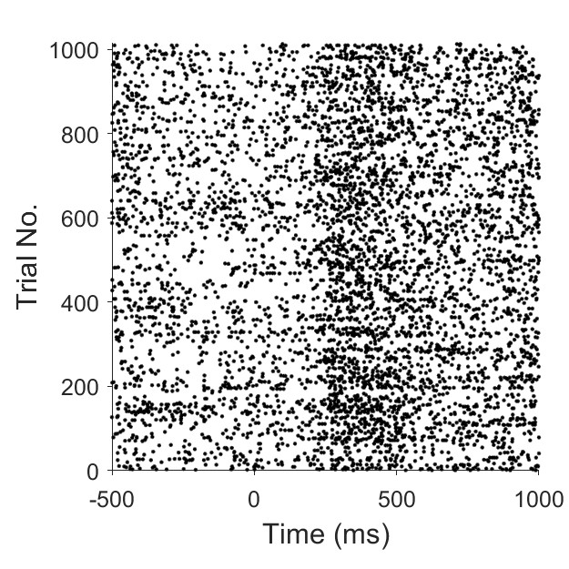
Replication of raster plots – original Fig. 4
Fig. 4 replication
Fig. 5 replication

Slide 3
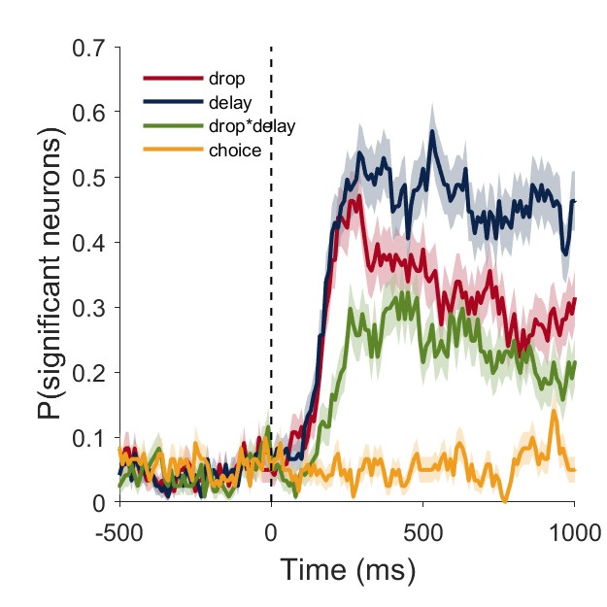
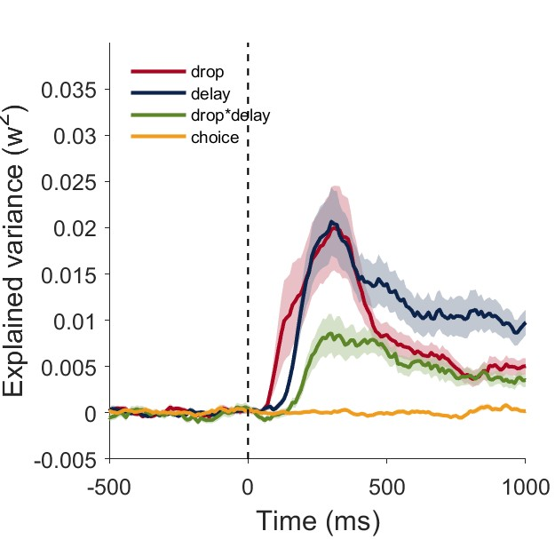
ANOVA + choice
The neural response in the cue period does not represent the type of choice
Effect-size plot
This plot confirms that most of the cells are representing
the reward related features and not choice.

Slide 4
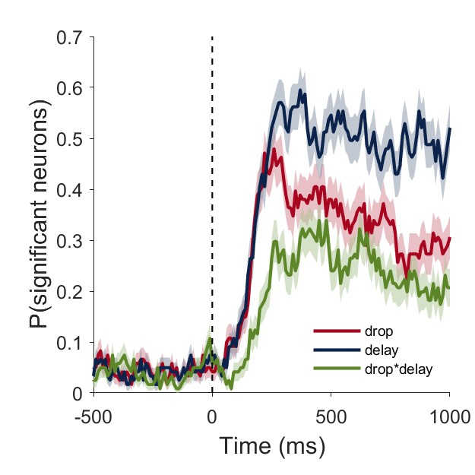
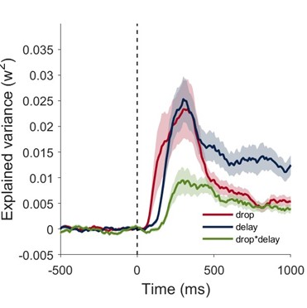
Replication of original Fig. 3 with 4 cells more. N = 121 and not 117 (because of skipped codes I missed 4 cells).
Since there is no choice information in the cue period, we then used only the neurons significant
for at least one factor of drop, delay and interaction.
Effect-size plot
This chart shows when we can get information about reward features.

Slide 5
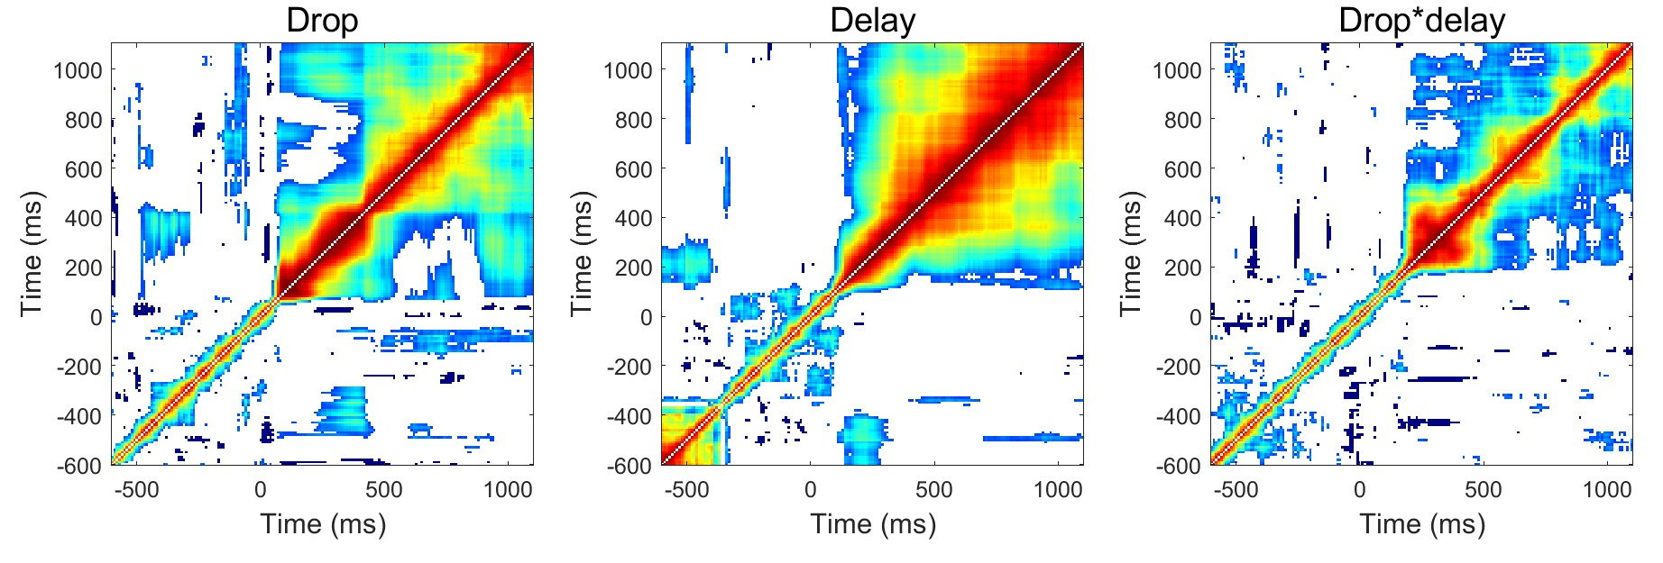
Sustained activity for drop, delay, and interaction (replication Fig. 6)
These figures describe how the same signal is carried over time.
Drop information is carried similarly for shorter time bins, while the delay for longer time bins.
Notes:
Sono confuse se

Slide 6
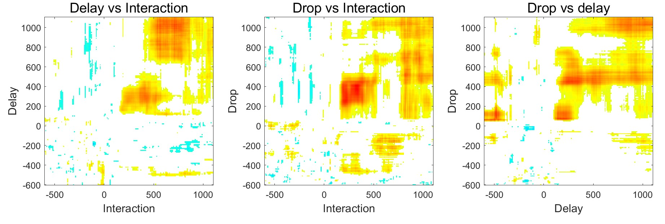
Sustained activity for drop, delay, and interaction (cross-correlation)
What are these?
What does it mean?
This may remind what I see in the previous heatmaps.
Notes:
Both drops and delay are positively correlated with interaction.

Slide 7
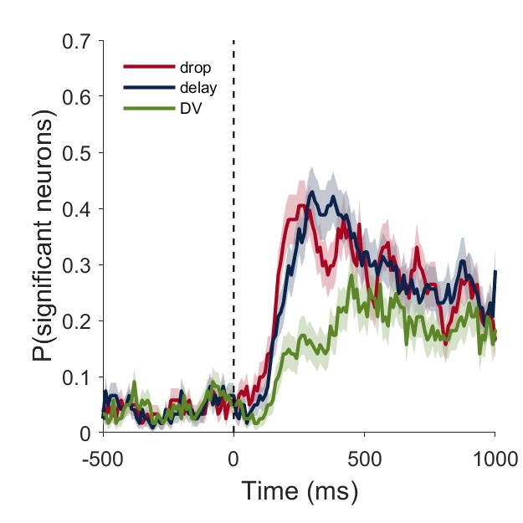
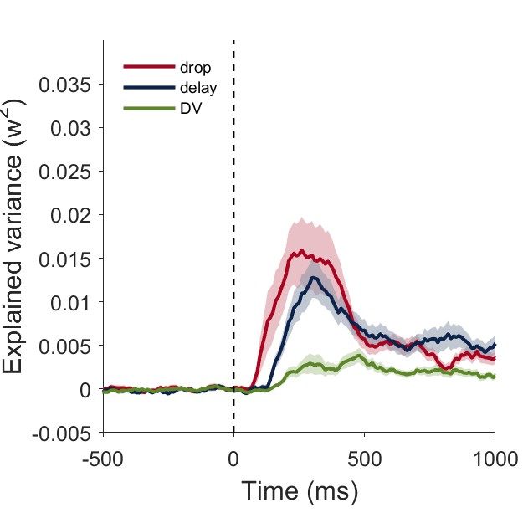
ANOVA: drop, delay, value (continuous variable)
ANOVA: drop, delay, interaction
(categorical variables)

Slide 8
ANOVA: drop, delay, value (continuous variable)
Effect-size plot
Notes:
It would be nice to know whether these are same cells or new cells are recruited, somehow.

Slide 9
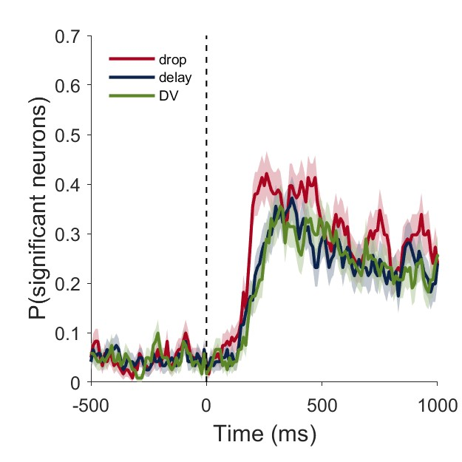
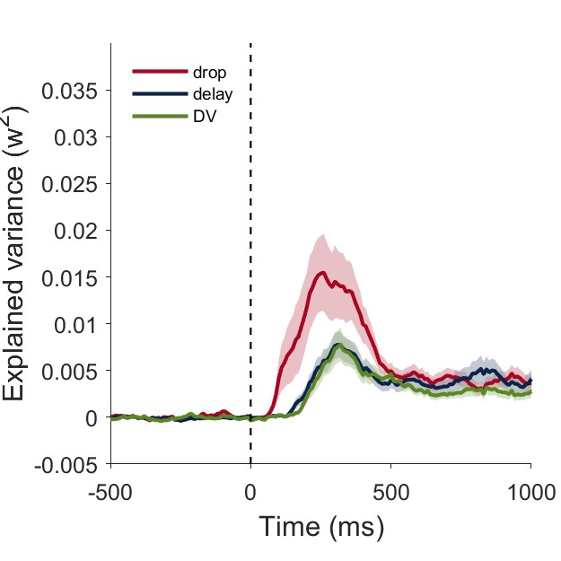
ANOVA: drop(cont), delay (cont), value(cont)
Effect-size plot

Slide 10
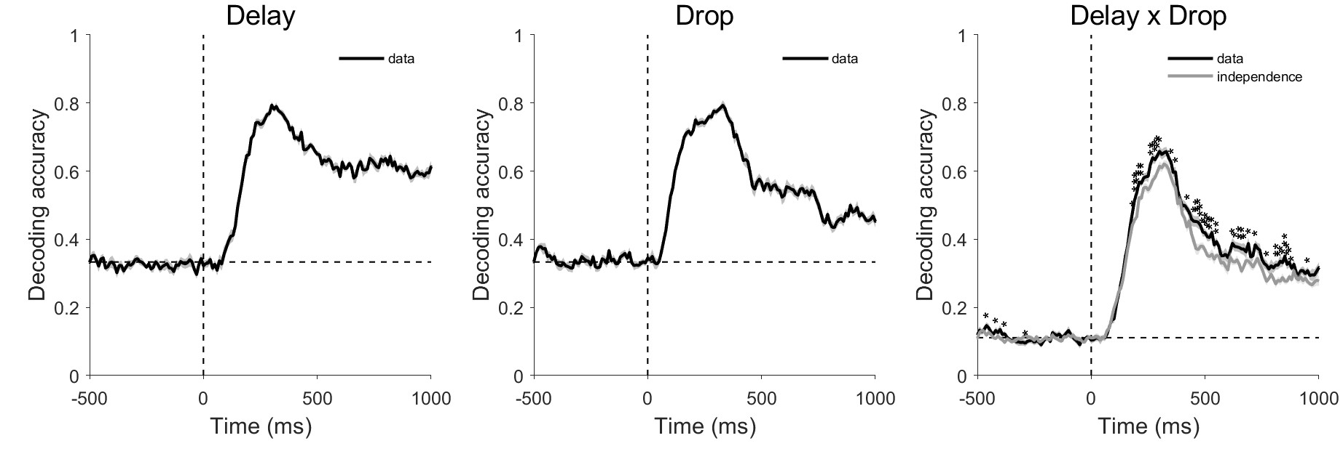
Decoding analysis
Notes:
Black: Decoding directly form the population of what cue is.
Grey: independent decoding of drop and delay.

Slide 11
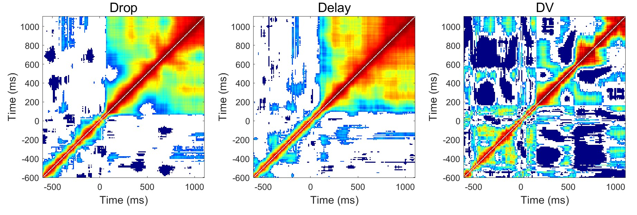
Sustained activity for drop, delay, and VALUE (auto-correlation)

Slide 12
Quantify “dynamic” vs “sustained” population activity

Slide 13
Quantify “dynamic” vs “sustained” population activity

Slide 14
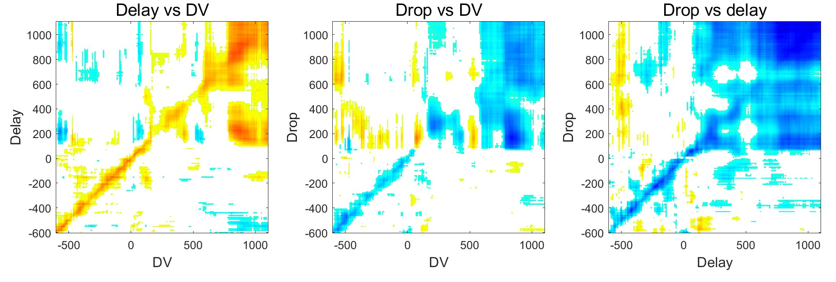
Correlation of coding dimension for drop, delay, and VALUE (cross-correlation)
Notes:
Delay is positively correlated with the DV. Drop is negatively correlated with the DV.
Drops and delay are negatively correlated.

Slide 15
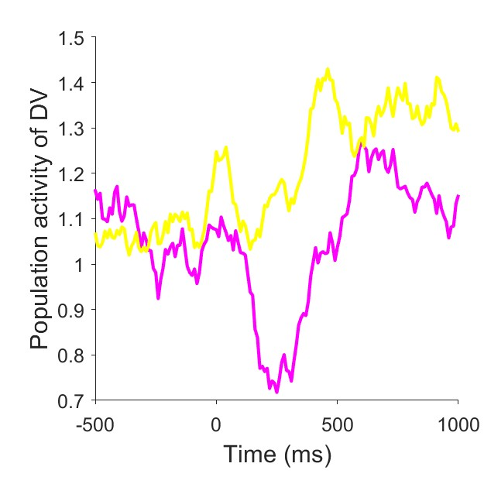
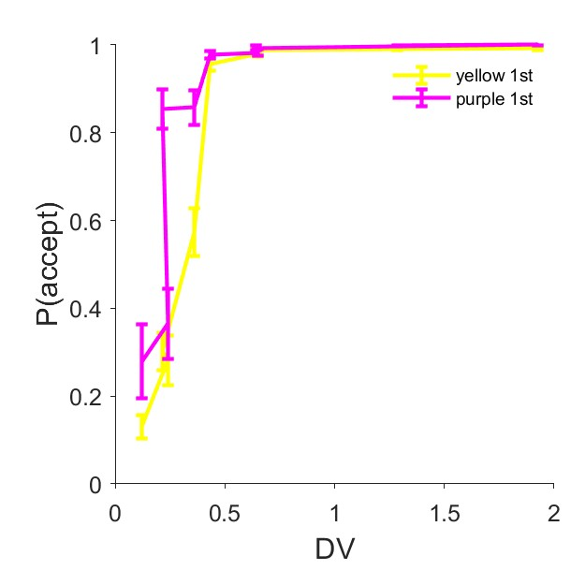
Yellow 1st vs Purple 1st

